Slide 1
Nagayya Nandan Revuri
Virtual Machine Scale Sets (VMSS):
Azure virtual machine scale sets let you create and manage a group of load balanced VMs. The number of VM instances can automatically increase or decrease in response to demand or a defined schedule. Scale sets provide the following key benefits:
Easy to create and manage multiple VMs
Provides high availability and application resiliency by distributing VMs across availability zones or fault domains
Allows your application to automatically scale as resource demand changes
Works at large-scale

Slide 2
Difference Between VM and VMSS: Key Differences between Virtual Machines and Virtual Machine Scale Sets. Scale sets are built from VM. If we want to add additional VM instances, VM Scale sets automatically create it from central configuration, traffic balancing and distribution, high availability and redundancy, and scaling of the VM. Azure Load Balancer: Azure load balancer evenly distributing load (incoming network traffic) across a group of backend resources or servers. *Public load balancer: can provide outbound connections for virtual machines (VMs) inside your virtual network.

Slide 3
*Private Load Balancer: is used where private IPs are needed at the frontend only. Backend and Frontend in Load Balancer: The backend server processes the request and generates a response. Meanwhile, the backend server periodically reports its current state to the load balancer. The backend server returns a response to the front end server, which is then forwarded to the user. Azure Active Directory: Azure active directory is Microsoft multi-tenant, cloud-based directory and identity management service. For an organization, Azure AD helps employees sign up to multiple services and access them anywhere over the cloud with a single set of login credentials.

Slide 4
RBAC (Role Based Access Control): Azure role-based access control (Azure RBAC) is a system that provides the access management of Azure resources. Using Azure RBAC, you can segregate duties within your team and grant only the amount of access to users that they need to perform their jobs. Three Types of RBAC: *Owner(admin): add user, modify and delete. *Contributer: Can do all the owner can do apart from user management. *Reader: it can only read and see the data.

Slide 5
Tenant and Subscription: A tenant is associated with a single identity (person, company, or organization) and can own one or several subscriptions. a subscription is linked to a payment setup and each subscription will result in a separate bill. in every subscription, you can add virtual resources (VM, storage, network) IAM (Identity and Access Management: Secure access to your resources with Azure identity and access management solutions. Protect your applications and data at the front gate with Azure identity and access management solutions.

Slide 6
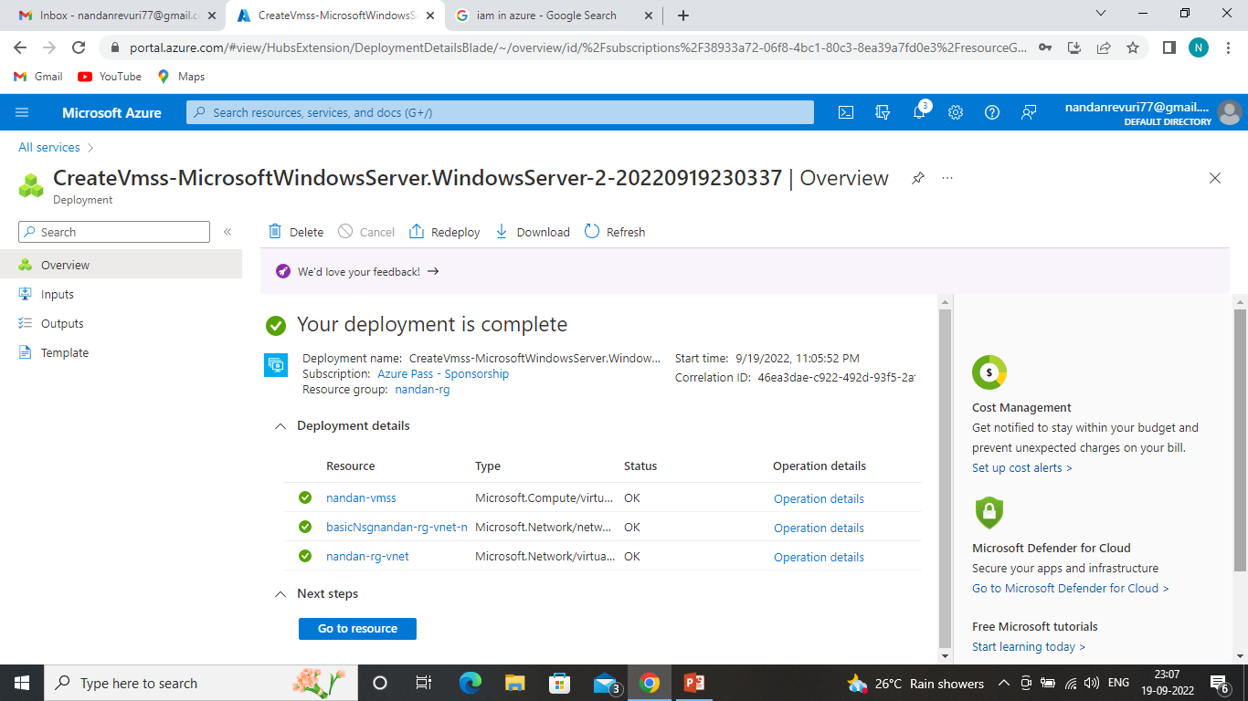

Slide 7
THANK YOU

